Slide 1
Pieces and Patches Quilt Guild
Show and Tell
May 2021

Slide 2
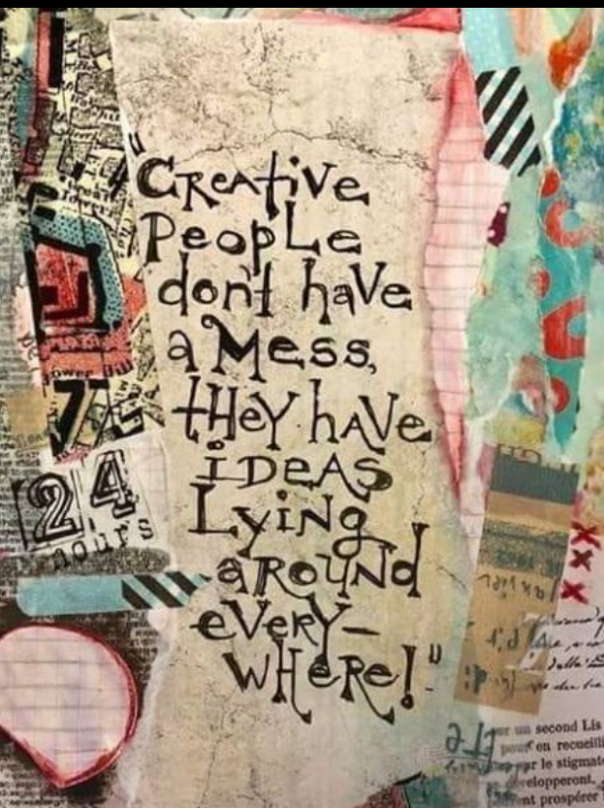

Slide 3
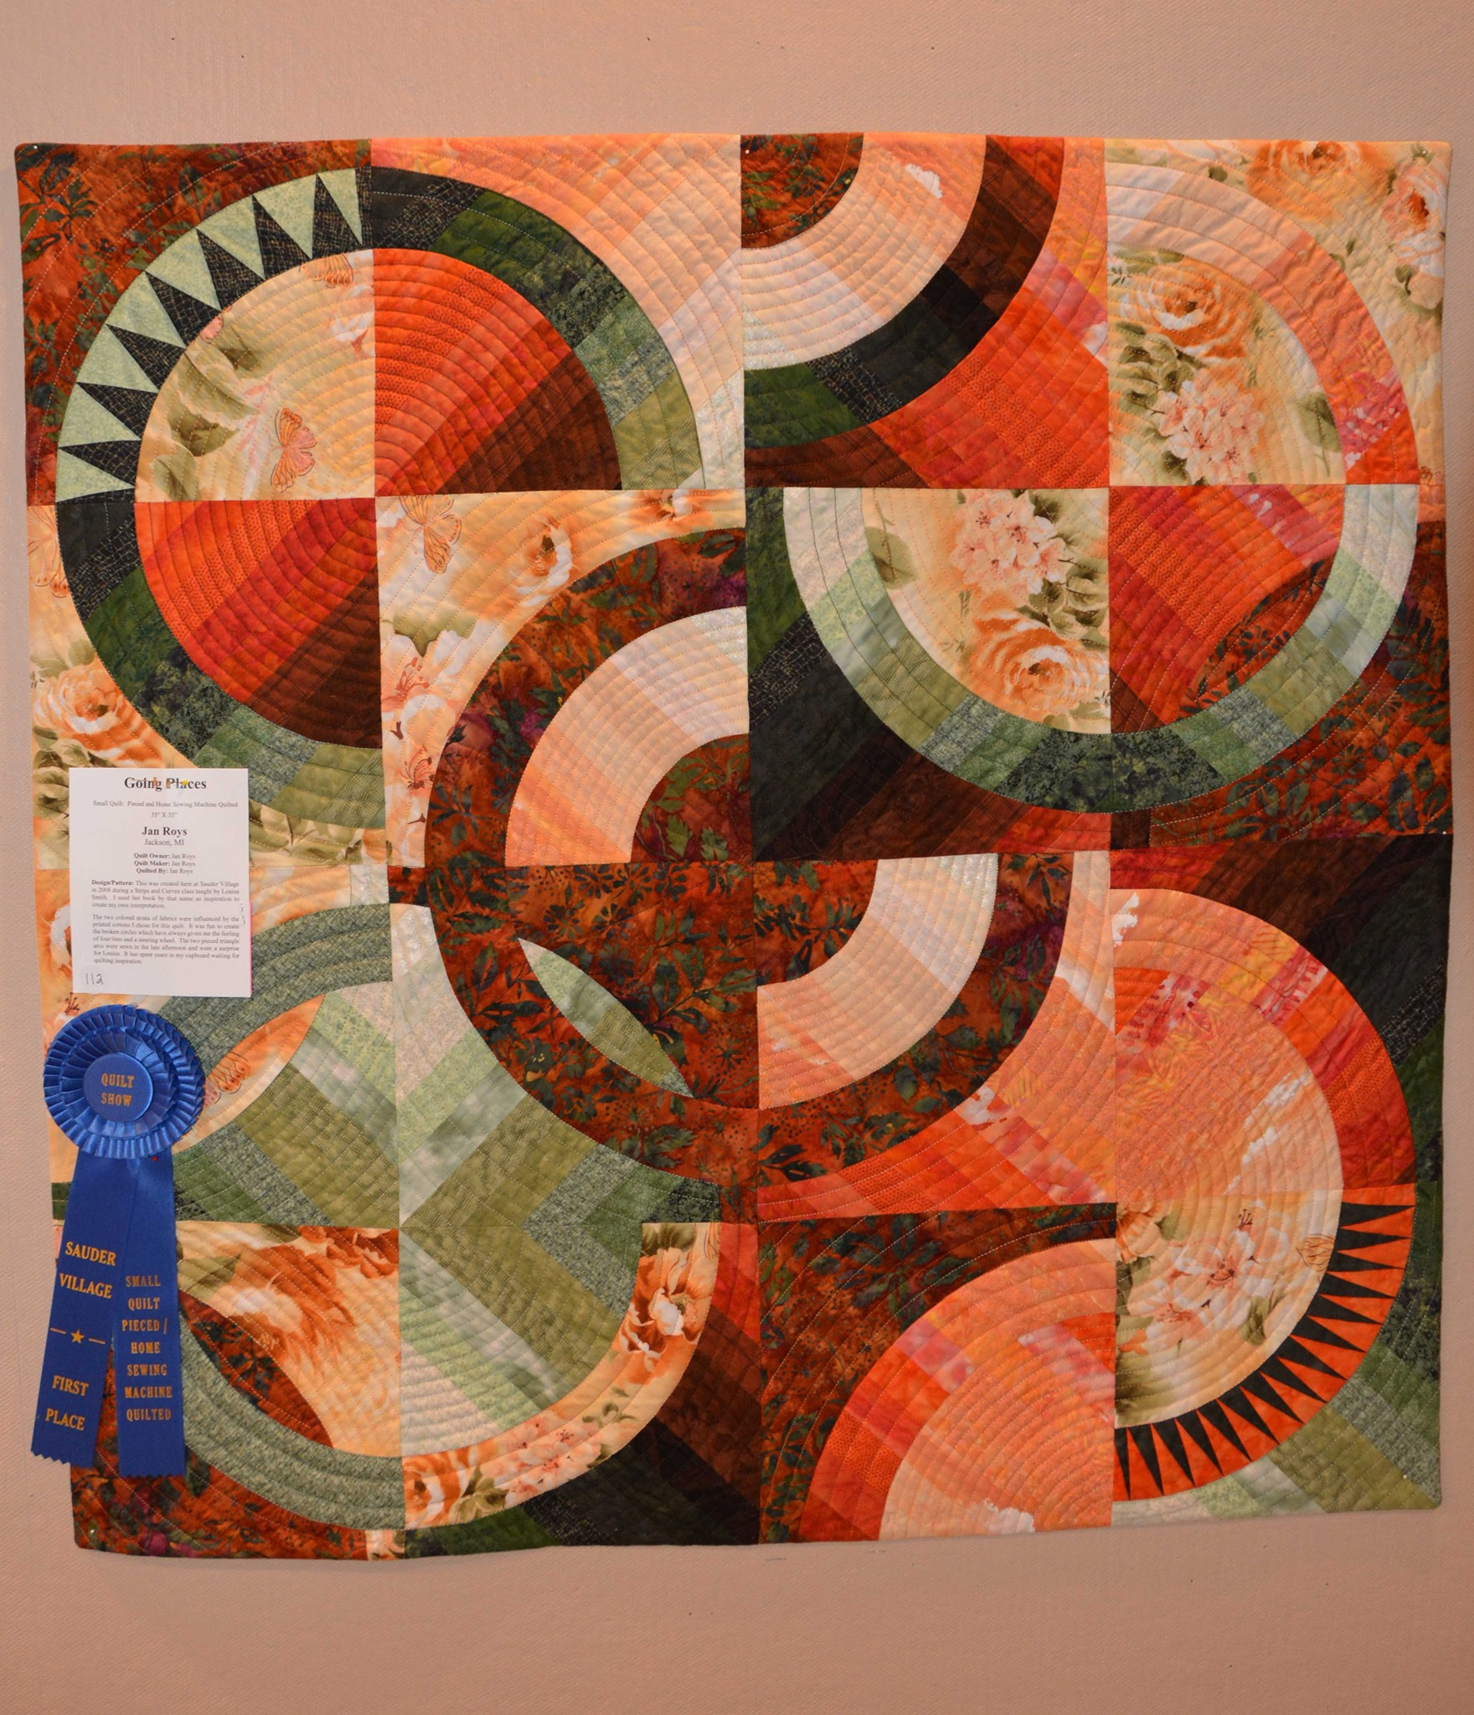
One of Jan Roys’ entries in the Sauder Village Quilt Show – Note the blue ribbon!

Slide 4
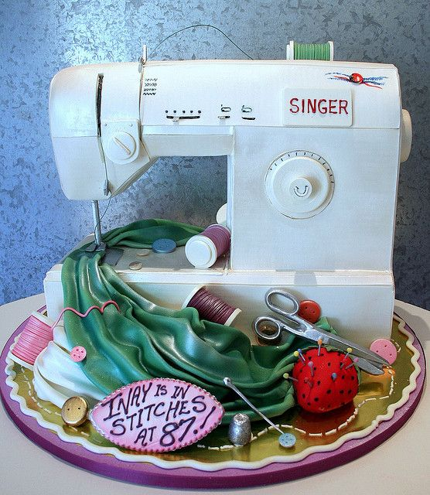
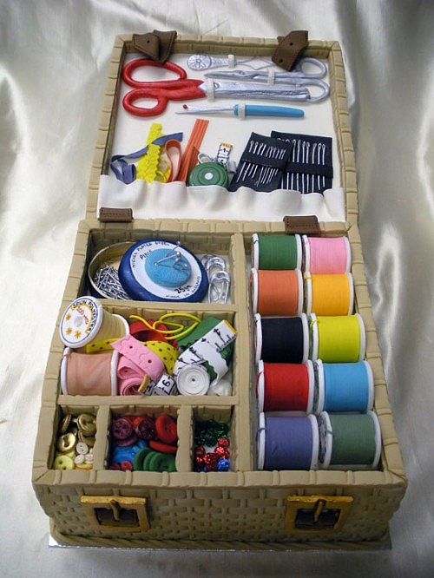
Can you believe these are CAKES?

Slide 5
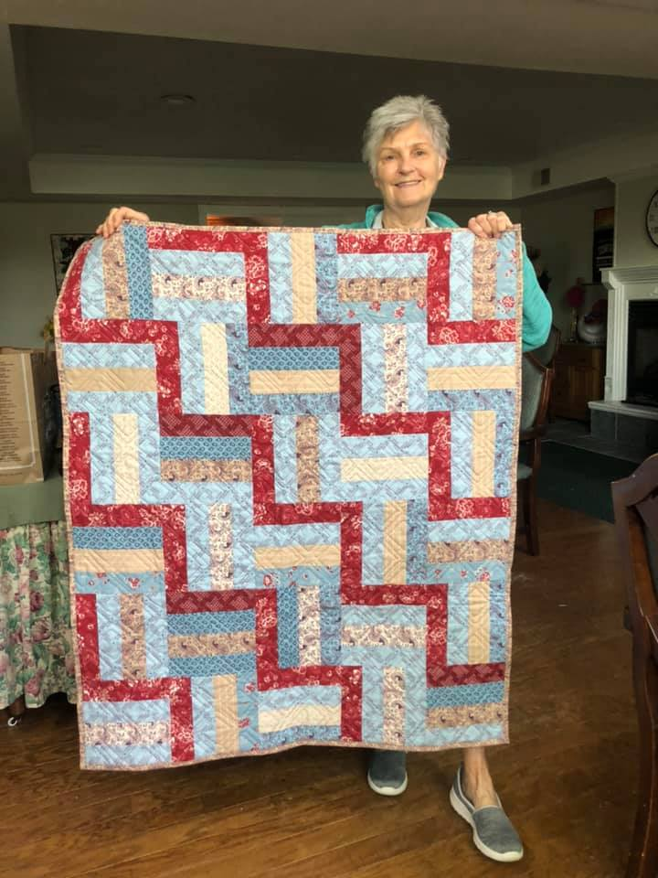
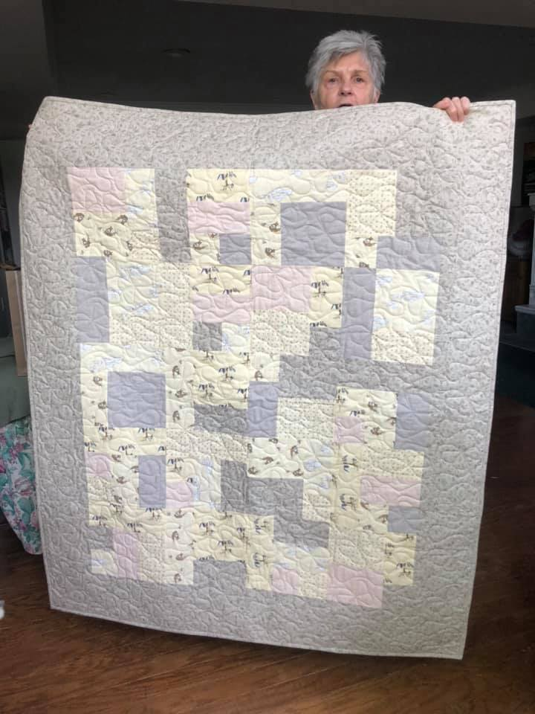
Linda Burke made several quilts for the Child Advocacy Center

Slide 6
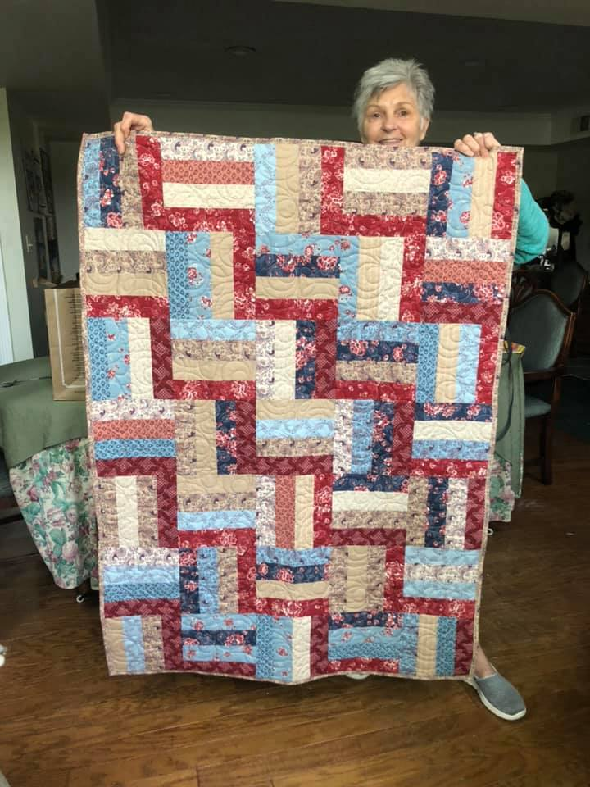
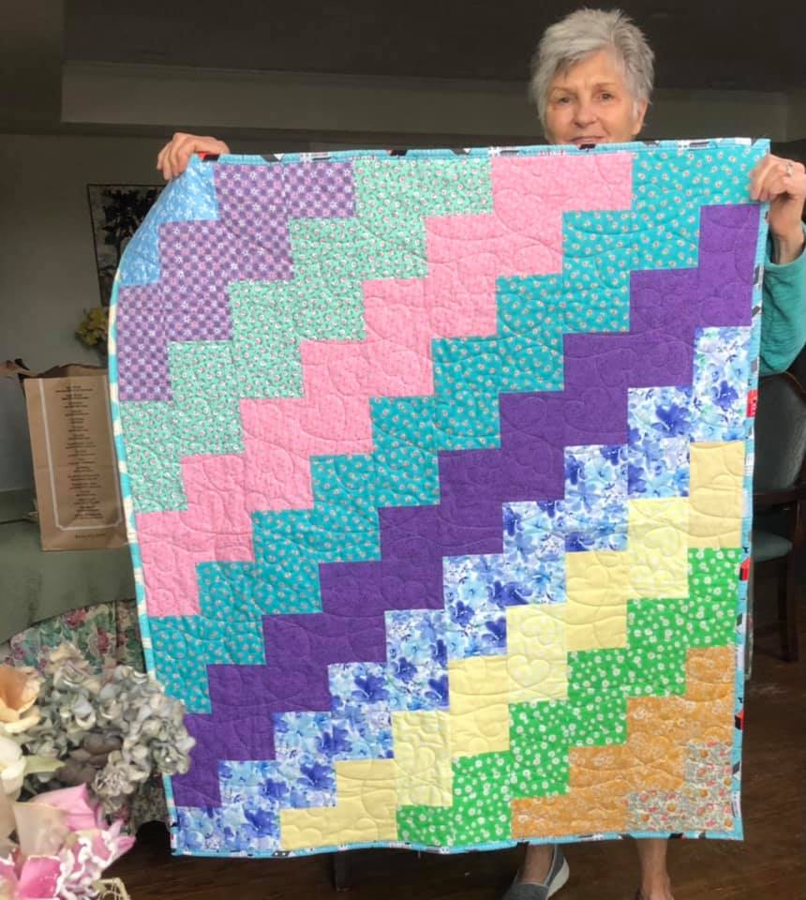
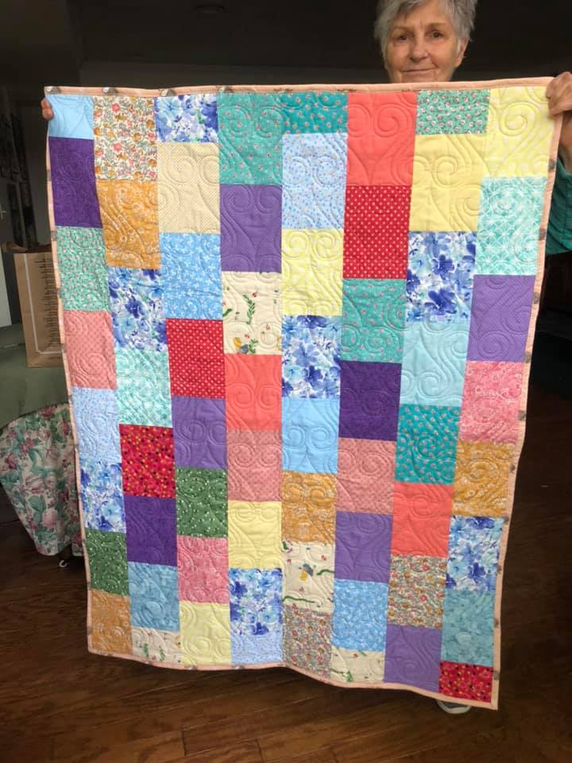
More of Linda Burke’s quilts for the Child Advocacy Center

Slide 7
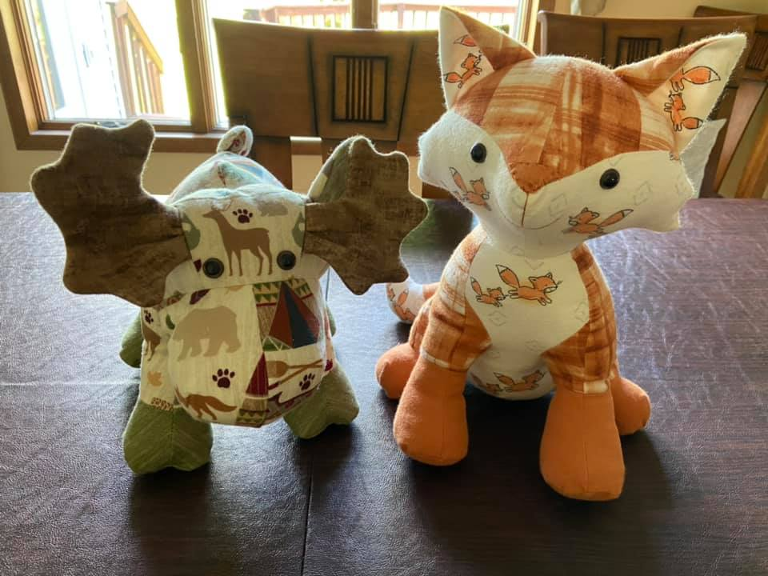
Two adorable toys made by
Anna Pedrotte for her new twin grandsons

Slide 8
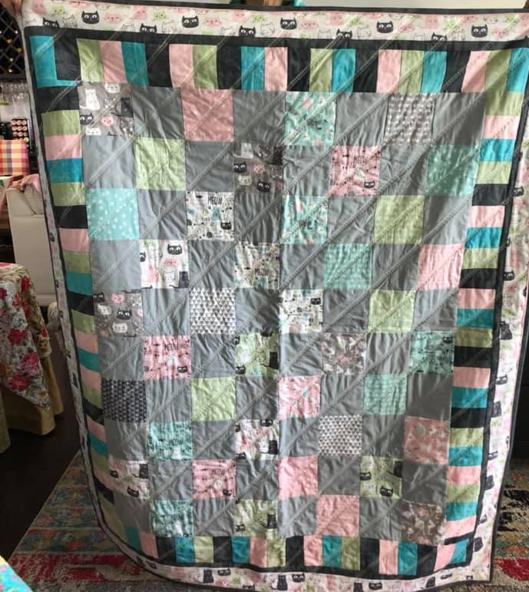
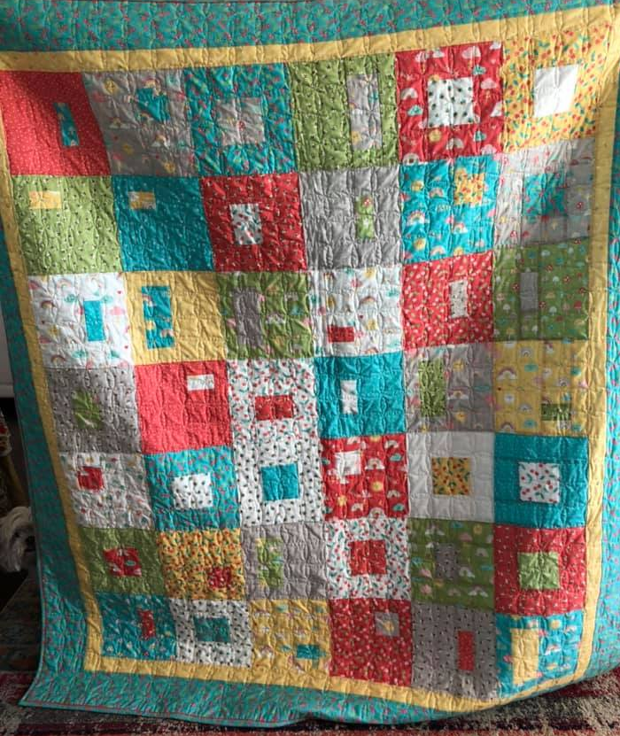
Two more quilts for the Child Advocacy Center

Slide 9
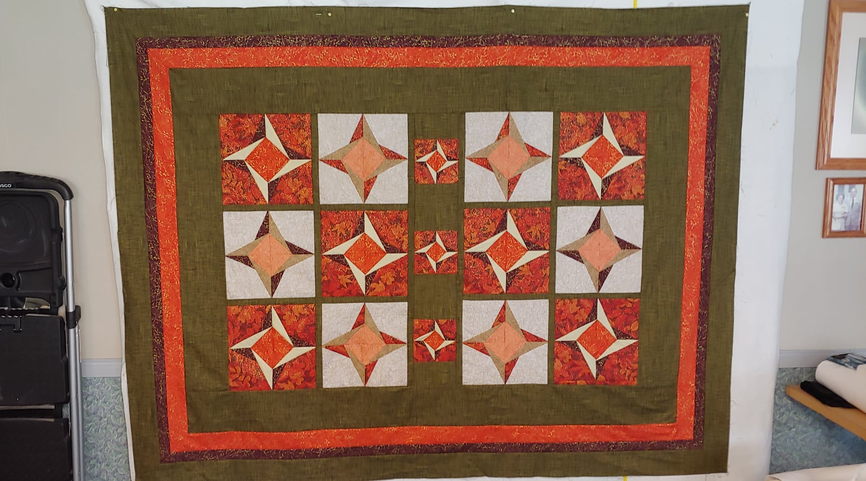
Rebecca Turner made this quilt top from the pattern called Foldstar

Slide 10
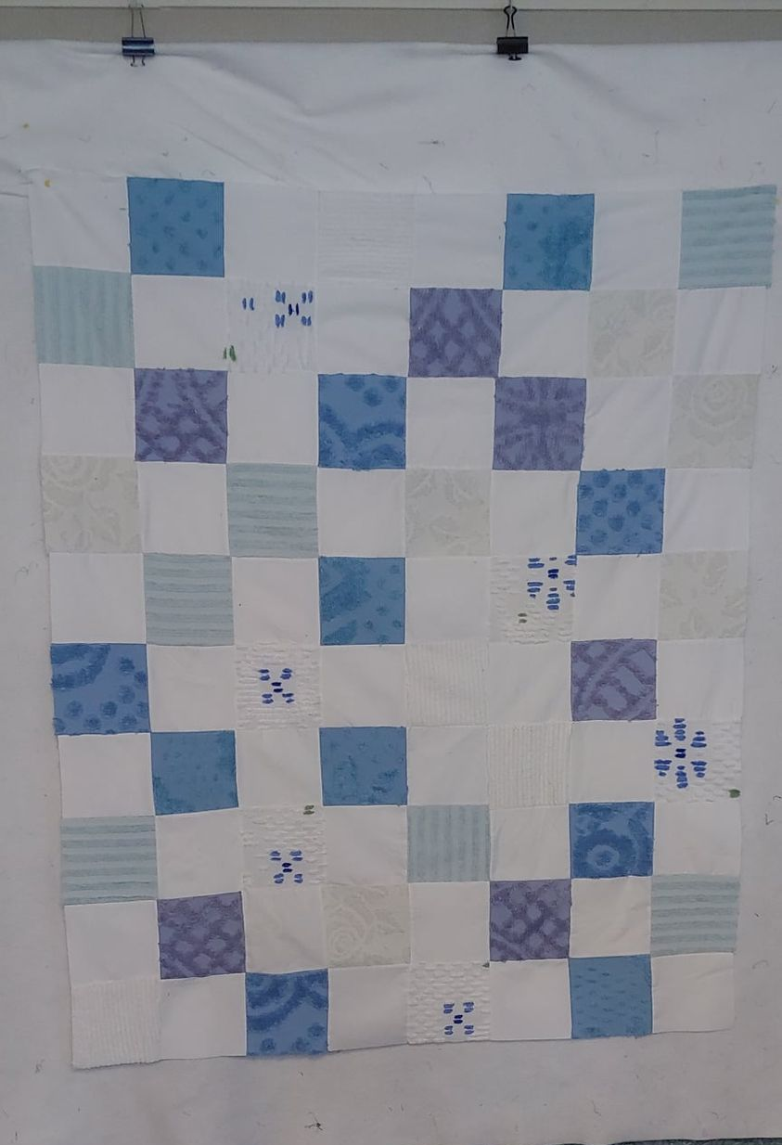
This is a chenille and flannel quilt top made by Rebecca Turner

Slide 11
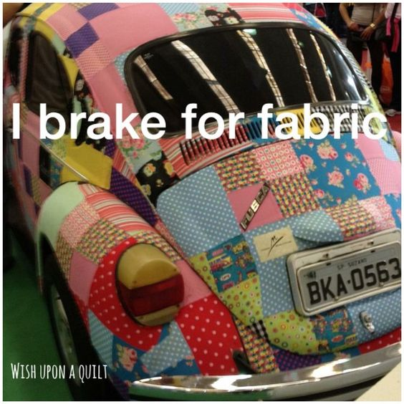
Is this perhaps your next car?

Slide 12
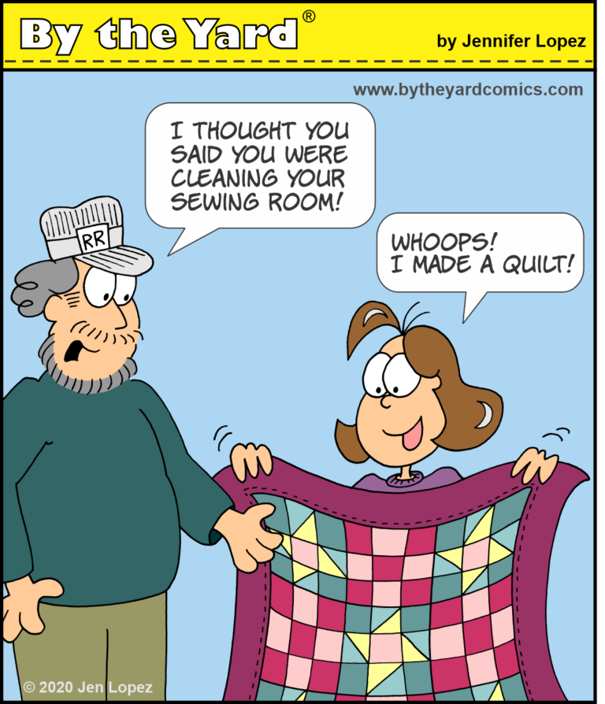
Can anyone identify with this?

Slide 13
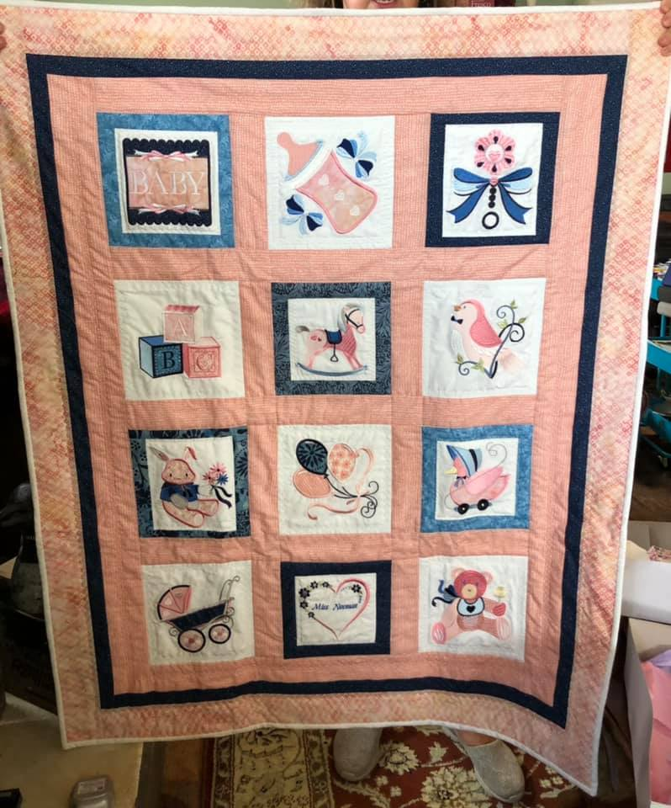
Janet Robinson made this darling quilt for a baby shower. It’s machine embroidery and applique.

Slide 14
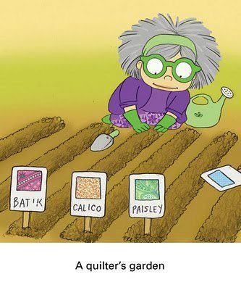

Slide 15
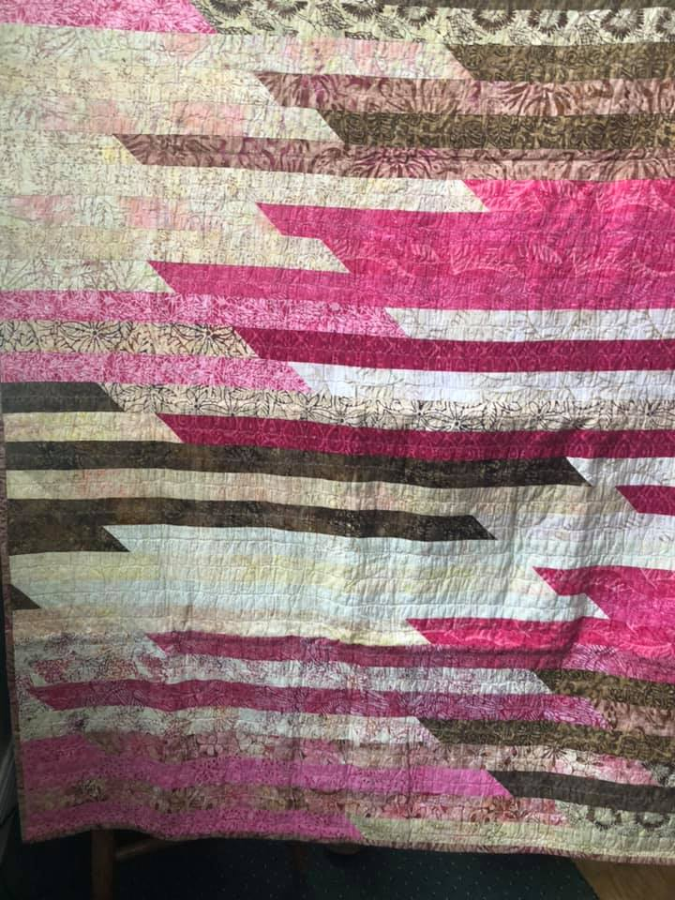
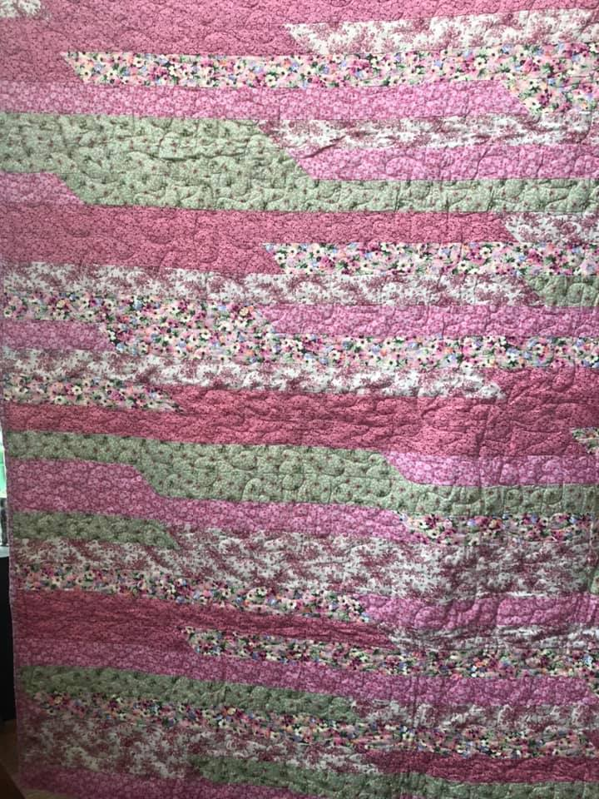
Zandra Kunzelman made these two pretty quilts for the Child Advocacy Center

Slide 16
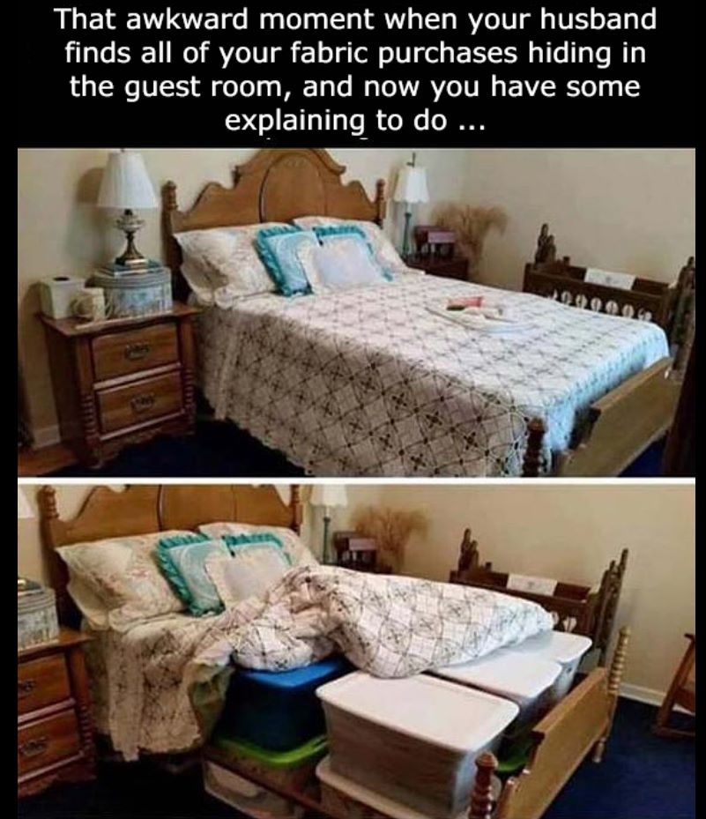

Slide 17
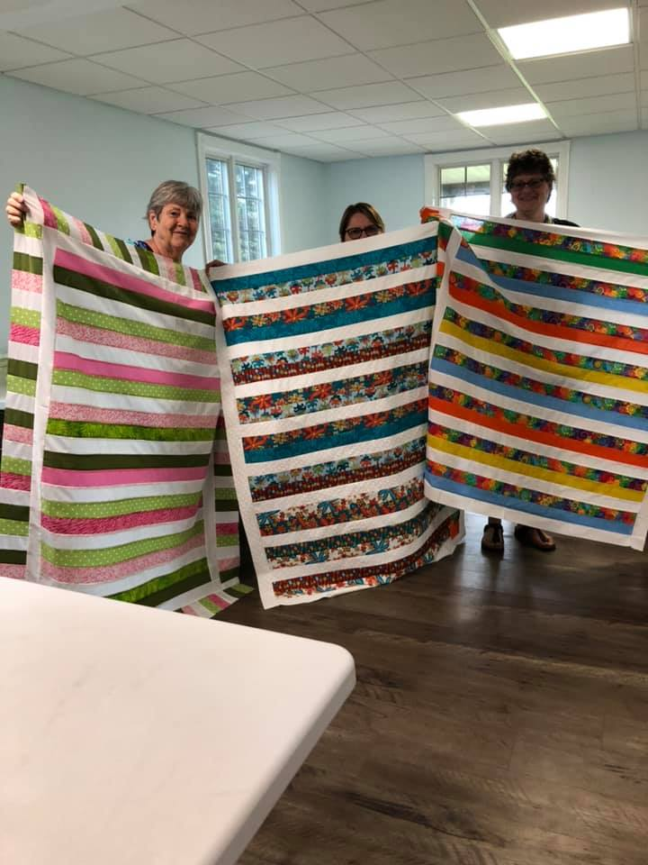
These three ladies, Barb Noble, Karen Clouse, and Rita Parsons, attended the most recent workshop that Janet held to make quilts for the Child Advocacy Center. Aren’t their quilts so pretty?

Slide 18
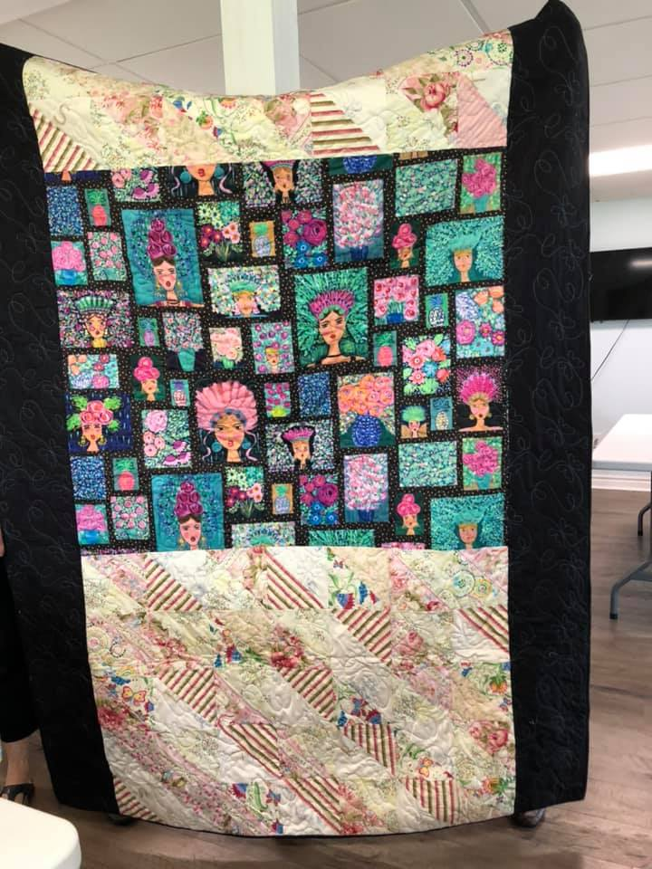
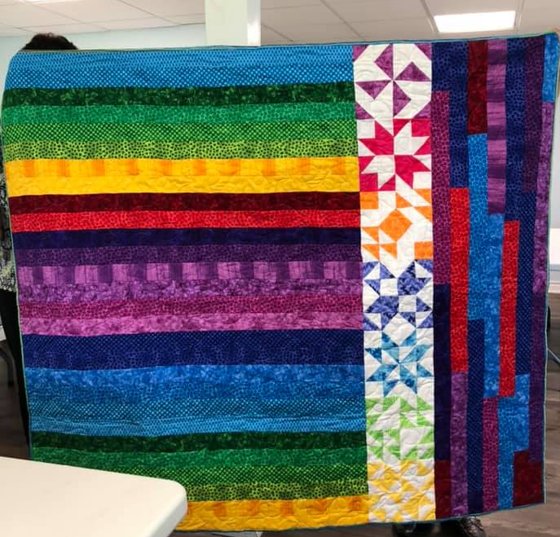
Carol Metz made these two colorful quilts and donated them to the Child Advocacy Center

Slide 19
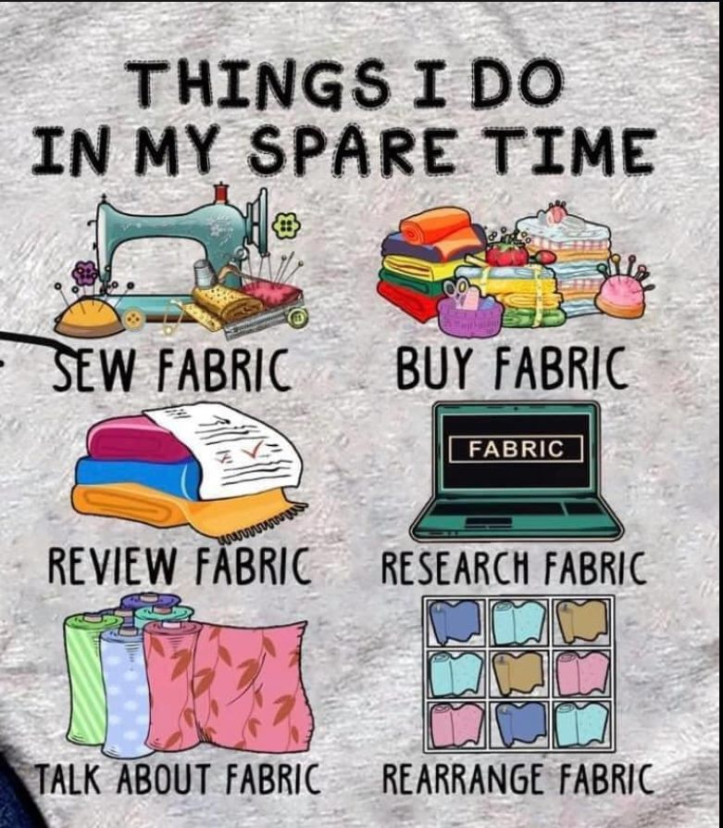

Slide 20
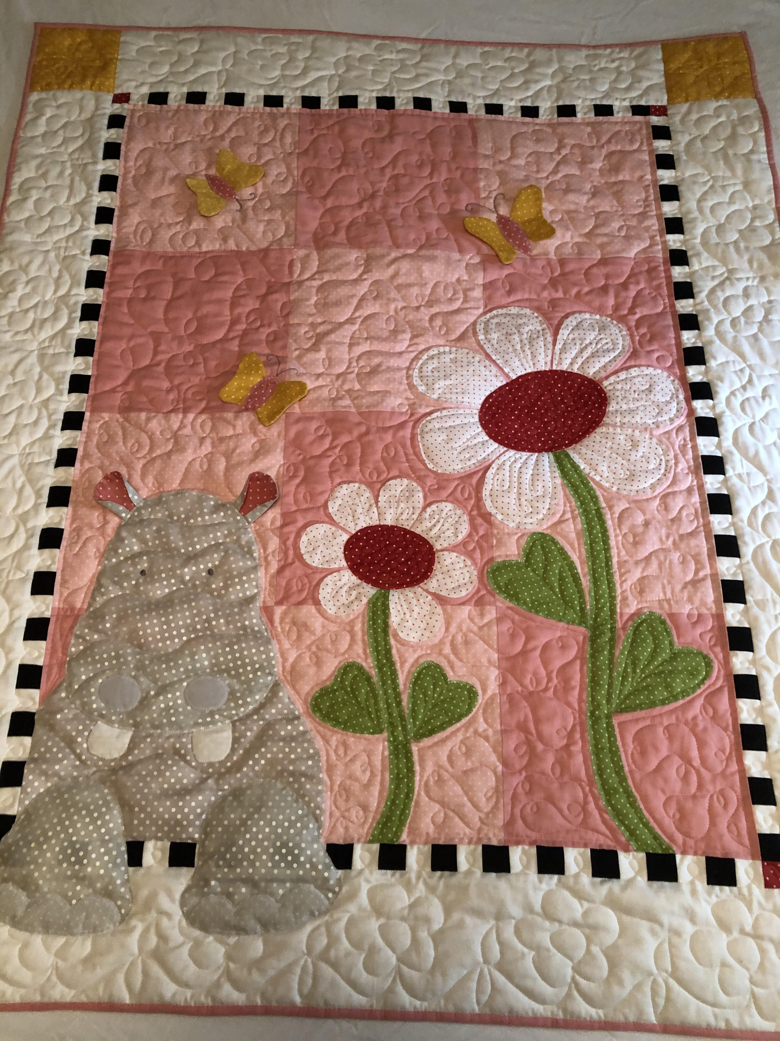
This darling quilt was made by Lisa Kirylo and quilted by Karen Trumble.

Slide 21
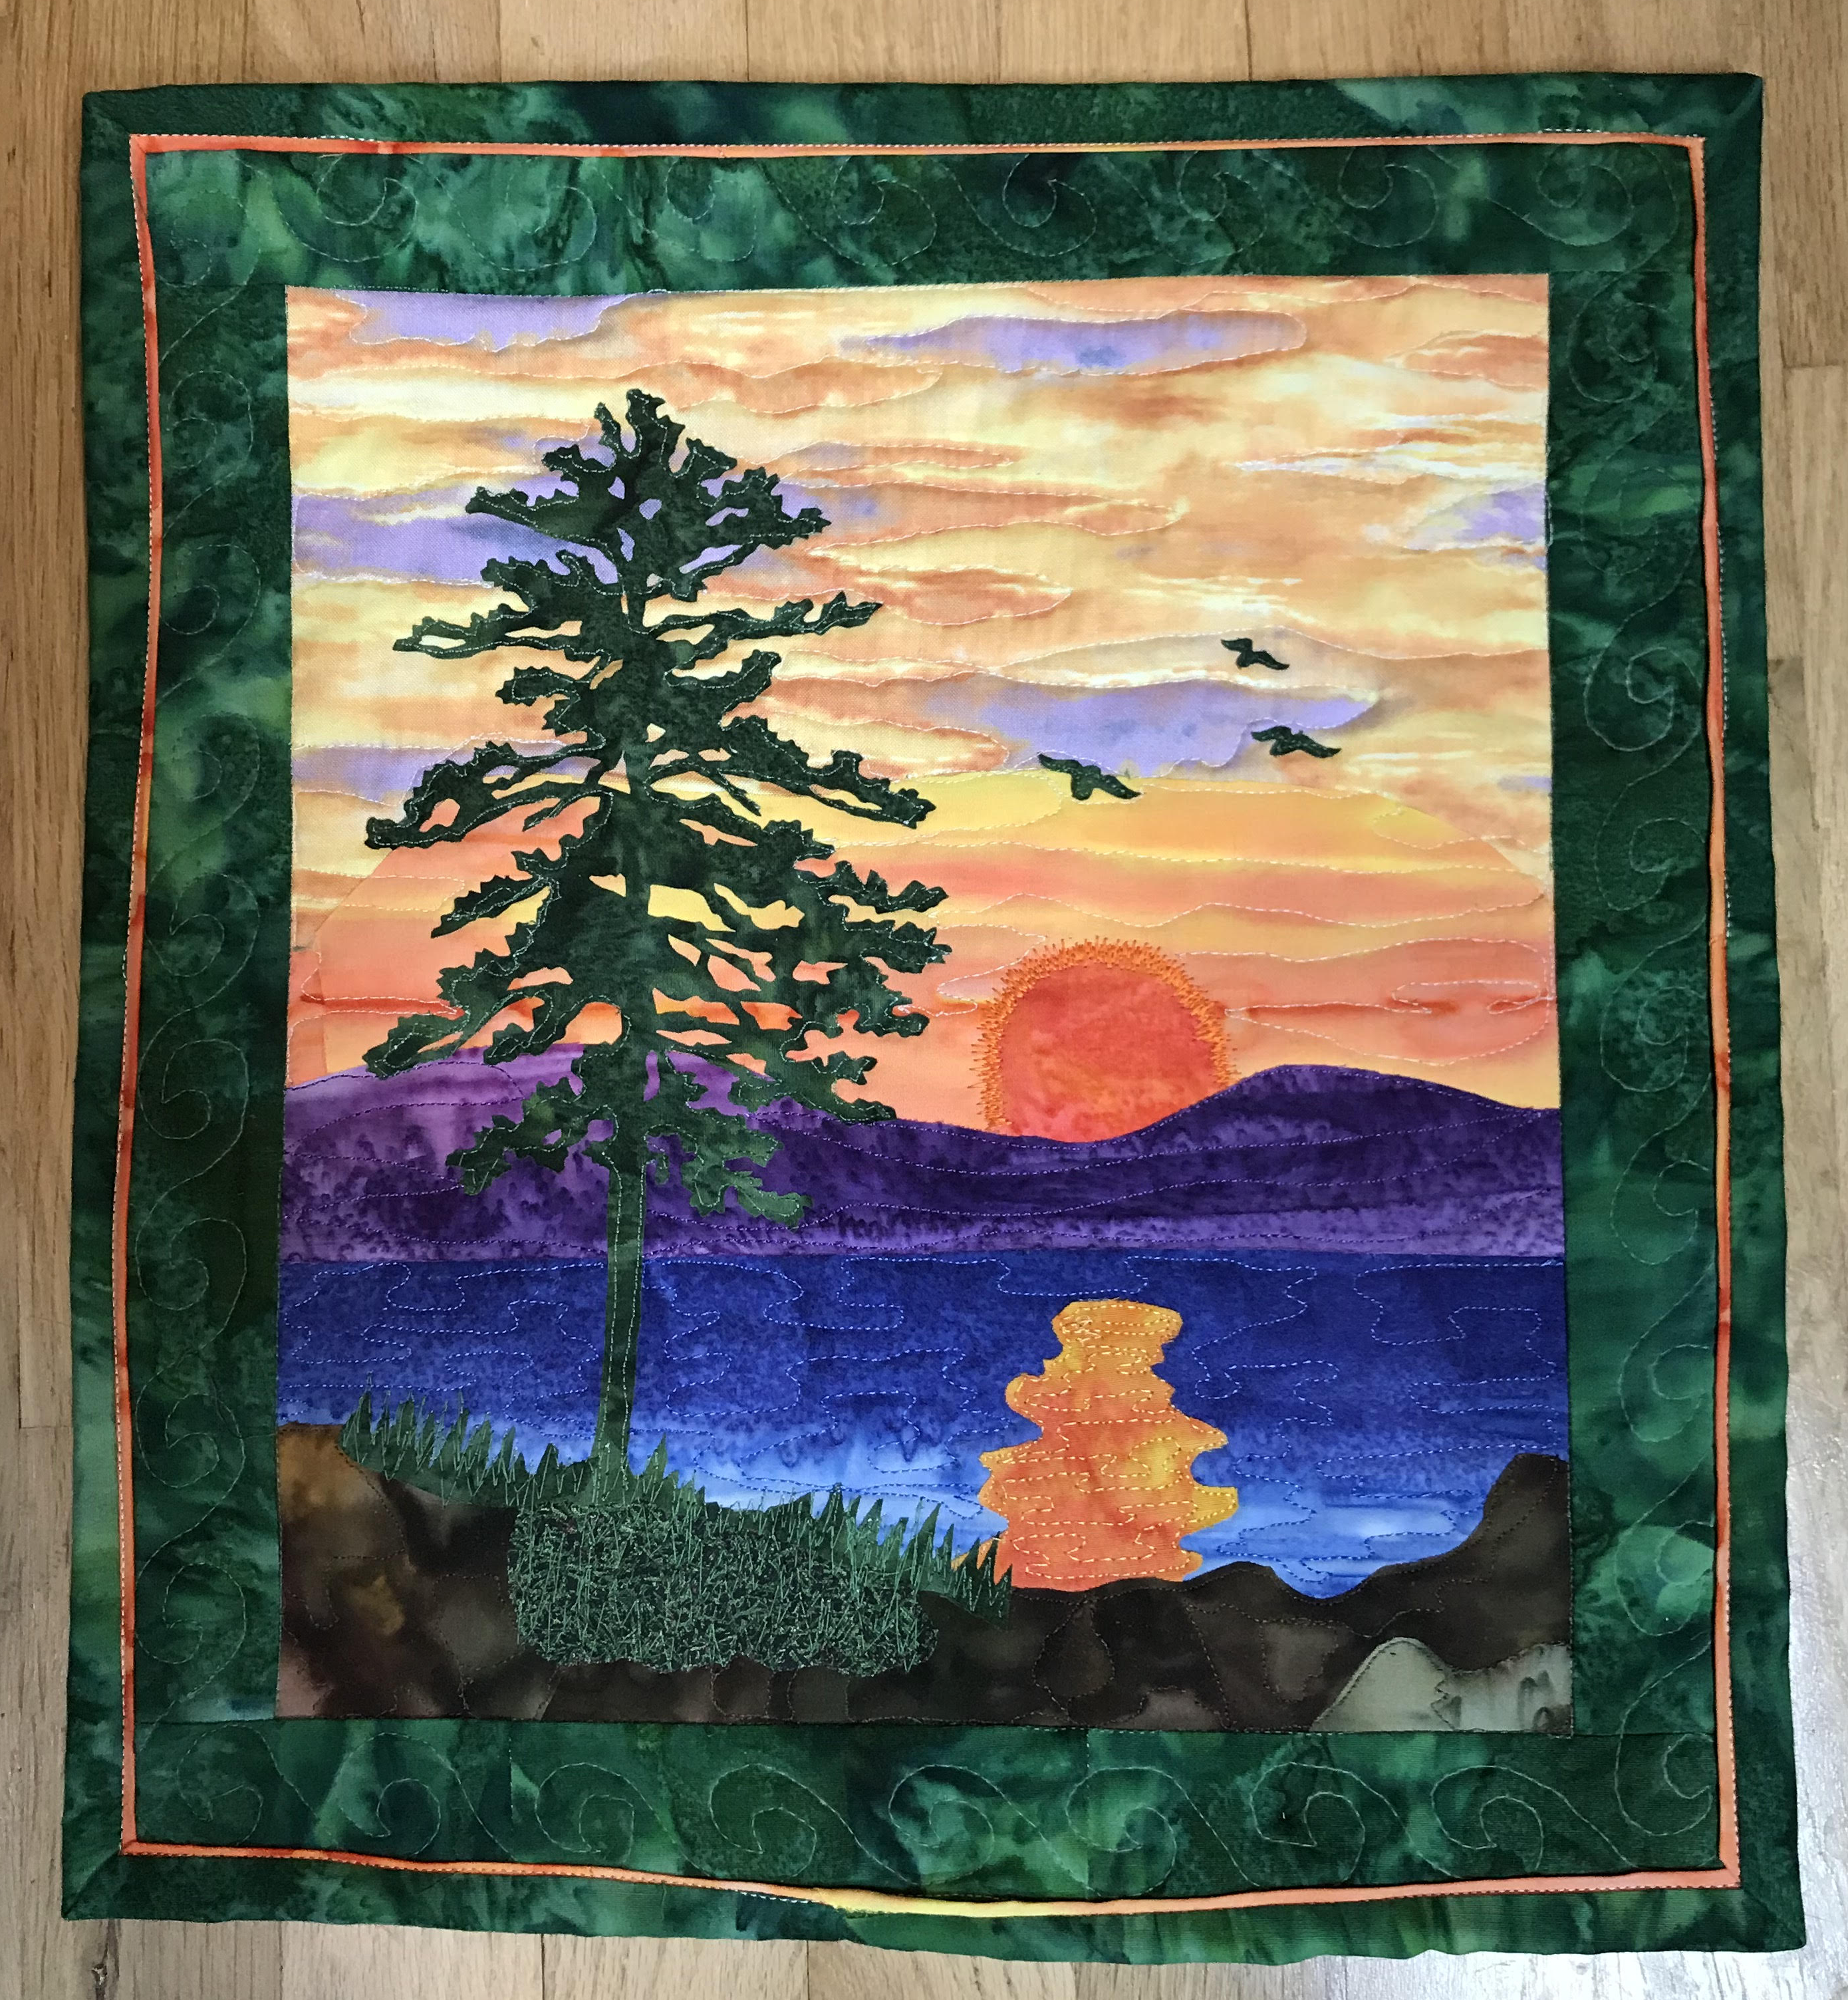
Here is a small landscape quilt made recently by Cathey Newhouse

Slide 22
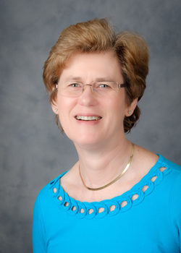
Our June speaker (June 28, 2021) will be Gloria Stickney, quilter, teacher, and owner of the Sew Fabulous Quilt Store in North Carolina. She will be talking to us about Finishing with Borders and Bindings, including 4 different ways of applying binding.

Slide 23
Thank you so much for coming tonight
and thank you for supporting the Pieces and Patches Quilt Guild

